Slide 1
Hearing Conservation Stand-down

Slide 2
Good Hearing is a Necessity
Survivability and Lethality:
50-60% of Situational Awareness comes from Hearing…
% increases in limited visual fields
Sound can be heard:
In the Darkness, Inclement Weather, or the Haze of Weapon Fire,
360 Degrees (You can’t see someone running up behind you, but with good hearing you can survive)
24 hours a day – 7 days a week
Ability to locate, identify sound source, aware of sounds
2

Slide 3
Consequences
Hearing Injuries are among the top four in theaters of operation
7/10 Injuries Due to Blasts – 50% Experience Permanent Loss
Permanent hearing loss is invisible (no blood), painless
By the time you know you’ve been injured, it’s too late…
Combat effectiveness is already compromised
Increased Safety Mishaps from loss of hearing (misinterpreting)
What are the consequences of not hearing correctly???
Attack vs. Get back
Watch um’ vs. Pop um’
Go vs. No
3

Slide 4
4

Slide 5
5

Slide 6
Lost Opportunities with Permanent Hearing Loss
Social:
Family & Friends
Professional:
Career Advancement
Meeting physical requirements
Firefighters, Homeland Security
Spec Ops, Pilot, Navigator, CDL License
6

Slide 7
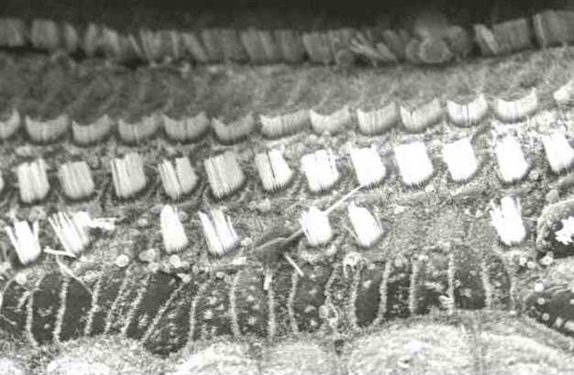
COCHLEAR HAIR CELLS
7

Slide 8
Know your numbers (level to hear)
-10 Super hearing
-5
0 Avg
5 Normal
10 Range
15
20
25
30 Mild Hearing Loss above 25 is HEARING LOSS
40
50 Moderate Hearing Loss
60 Larger the Number
70 Severe Hearing Loss Greater the Hearing Loss
80
90 Profound Hearing loss
8

Slide 9
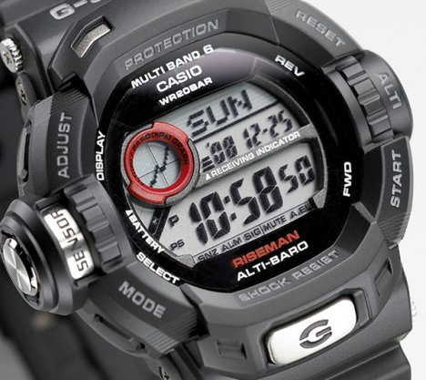
What determines noise damage? How loud and How long
60 dB: Normal Conversation
85 dB: Damaging Level
95 dB: Lawn Mower/Weed Eater
130 dB: Shotguns/NASCAR
150 dB: Jet Engines
170 dB: Rifles & 50’’ Caliber Weapons
180 dB+ Explosions/IED’s
Noise Exposure Limits when Criterion Level = 85 dB(A)
3 dB(A) Exchange Rate | Maximum Permitted Daily Duration (hours)
Allowable Level dB(A)
85 | 8
88 | 4
91 | 2
94 | 1
97 | 0.5
100 | 0.25
9

Slide 10
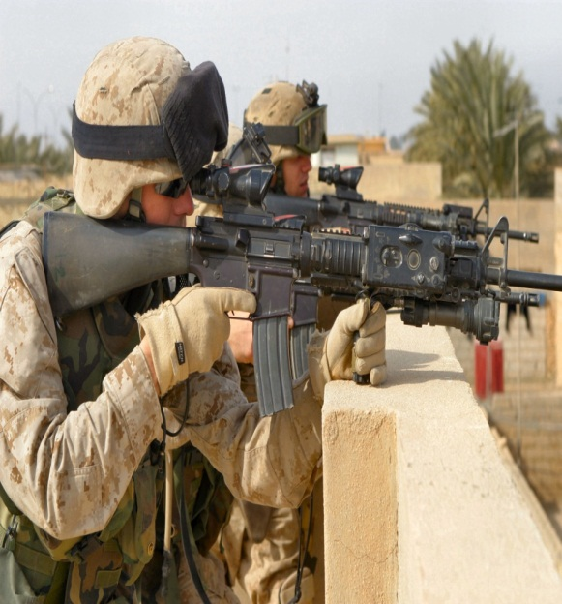
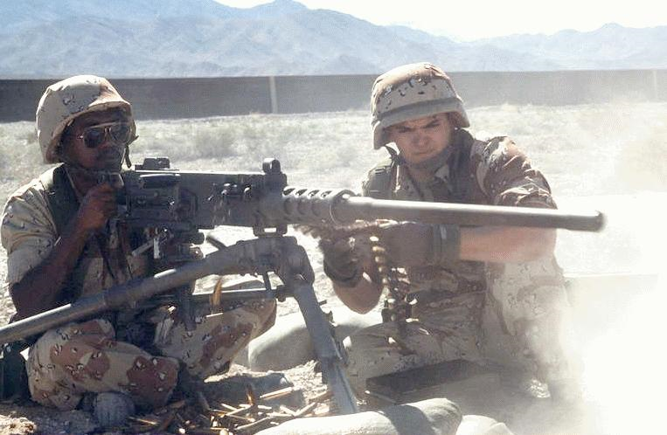
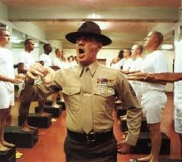
NOISE AT WORK
Generators (95dB)
Screaming DI (100dB)
M-16 (130-150dB)
50 Caliber (170 dB)
Explosions/IED’s (180 dB+)
10

Slide 11
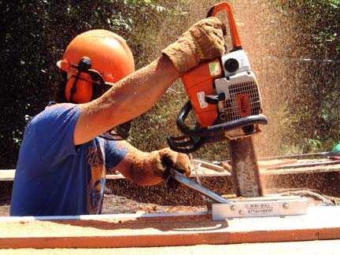
NOISE AT HOME
Power tools…….94 dB
Lawn care………94 dB
Chain saw……..110 dB
Engine repair....100 dB
Shop work…….104 dB
11

Slide 12
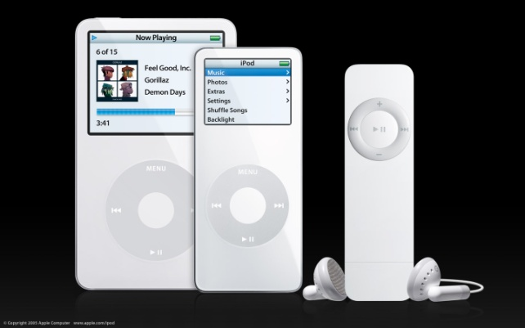
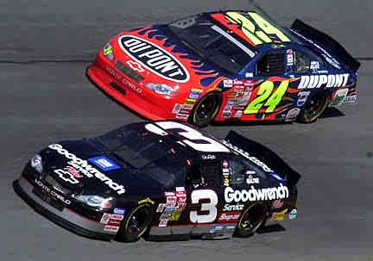
NOISE AT PLAY
Auto racing (130-150dB)
Jet skiing, Motorcycles (95dB)
Hunting / Shooting (130-170dB)
Rock concerts (110-130dB)
Loud music: cars, MP3, IPOD
12

Slide 13
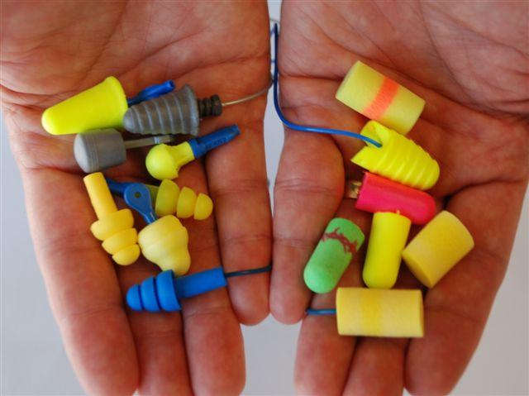
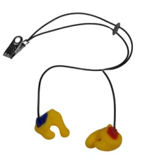
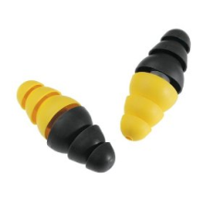
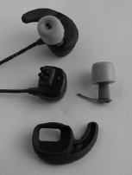
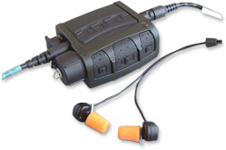
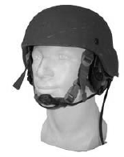
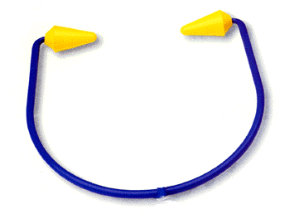
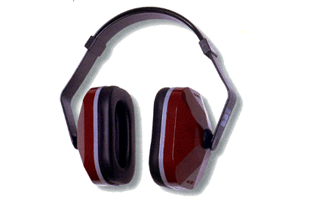
Hearing Protection Devices
*Like your rifle, these weapons will not help you without minimal training & understanding of how they work!
13

Slide 14
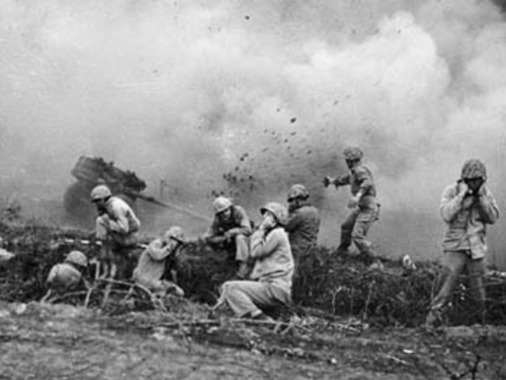
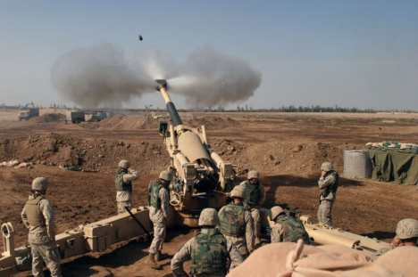
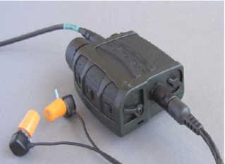
Korea 1951
Better Combat Solutions?
Fallujah 2007
.
Notice Their Choice of HPD
14

Slide 15
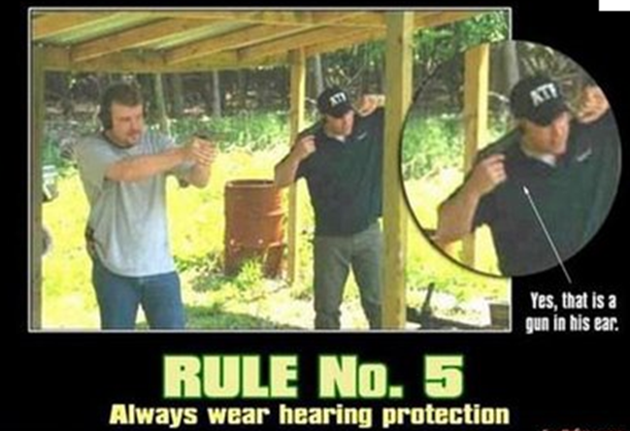
15

Slide 16
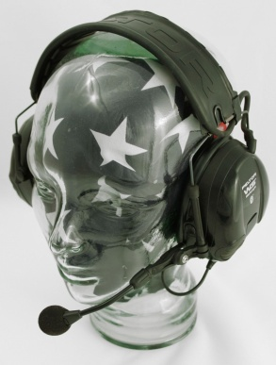
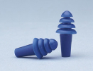
HPDs and Communication Ability
Wear HPD when exposed to hazardous noises
Noise Situations: Communication Not Critical
Basic Foamies, Quad Flange, Ear Muffs
Noise Situations: Communication Critical
Combat Arms Earplugs, TCAPS
16

Slide 17
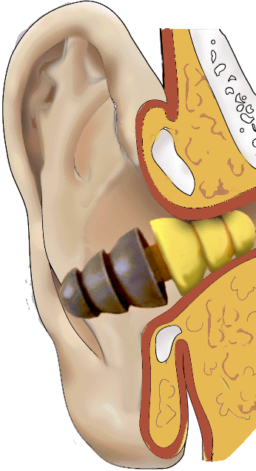
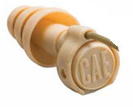
Combat Earplugs
Impulse noise
Gun shot
Hear more
Steady noise
Generator noise
Blocks more
Olive out:
(harder to see)
Yellow out:
(easy to see)
Open:
(hear more)
Closed: (blocks more)
17

Slide 18
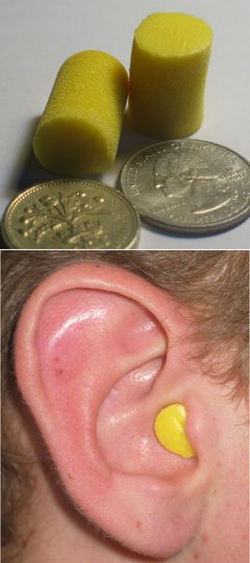
How to correctly wear hearing protection.
Right
Foamies:
Roll or squish the earplug
Pull back on ear w/opposite hand
Straightens ear canal for DEEPER insertion
Insert the earplug
Should not be able to see your buddy’s
Foamie if looking directly at him or yourself if looking directly in a mirror
Wrong
18

Slide 19
Real-World Hearing Protection
NAVAIR 14MAR06
19
Notes:
Explanation: The most meaningful way to look at earplug insertion depths was to consider each ear individually. Had each subject’s left and right earplug insertion depth been studied, the two (left / right) earplug insertion depths would have had to have been averaged together; or the minimum earplug insertion depth used; or the maximum earplug insertion depth used. These three options elicited a less clear picture of what occurred than looking at each earplug independently.
85% of subjects’ left and right earplugs were ≤2 mm different for insertion depth (8 mm was the maximum difference between left and right earplug insertion depth). No correlation could be found between similar left / right earplug insertion depths and achieving optimum earplug insertion depth of ≥20 mm.
Noise Reduction Ratings from earplug insertion depth study completed by the Air Force Research Laboratory using American National Standard S12.6-1997 (R2002) Methods for Measuring the Real-Ear Attenuation of Hearing Protectors, Method A (Experimenter Supervised / Verbally Coach), mean minus two standard deviation

Slide 20
Many reasons why HPDs are not worn:
Afraid of not hearing, not comfortable, problems inserting, not seen as important, hearing is not that bad, inconvenient, extra hassle, not available
Many solutions:
Different types, sizes and filters: discuss options
In noise on the job and at home
Wear CONSISTENTLY and CORRECTLY!
Noise induced hearing loss is:
PERMANENT and PROGRESSIVE
20

Slide 21
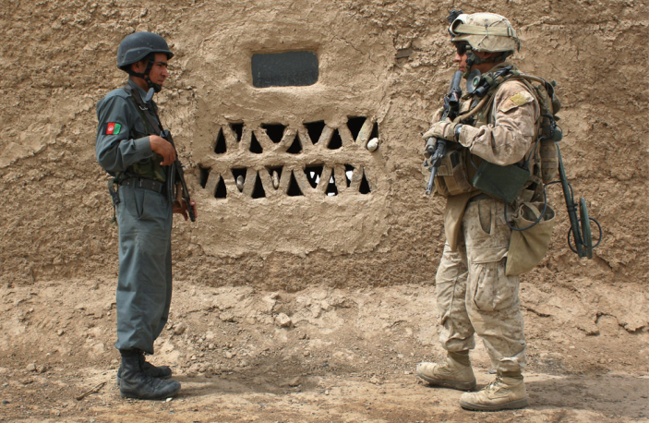
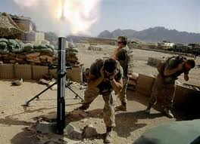
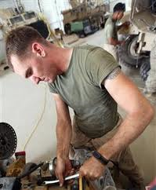
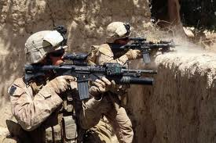
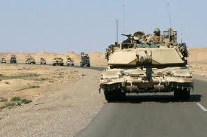
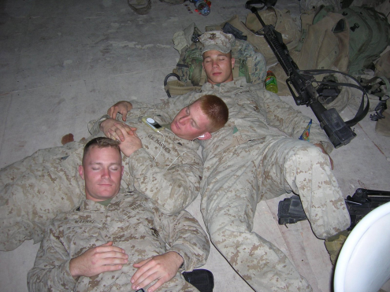
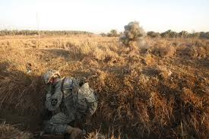
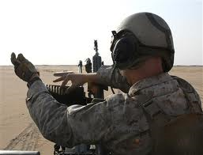
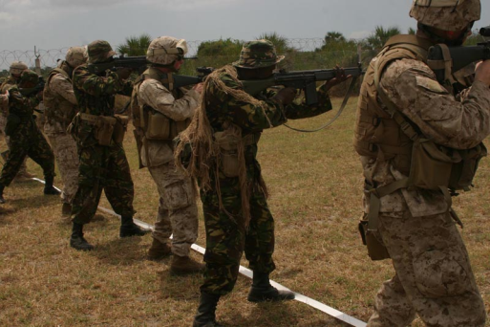
Ears need auditory rest too
21

